Slide 1


A Transformer-Based Classification: Semantic Context Evaluation for Mobile Spam Message Detection
Final Defense for Project of Project Based Learning 2026
College of Global AI Convergence, Seoul Christian University

Slide 2

Outline
Presentation Roadmap
Why SMS spam detection needs more than keywords (Introduction)
Dataset, exploratory analysis and preprocessing (Weeks 3–4)
Three models: TF-IDF + LogReg, BiLSTM, DistilBERT (Weeks 5–9)
Results, semantic case studies and conclusion (Weeks 10–15)

Slide 3
01
Introduction

Slide 4
Introduction
SMS Spam Is a Security Threat
Objectives
Billions of SMS messages are sent every day, so spam and smishing (SMS phishing) thrive
Harms: financial loss, credential theft, malicious links, lost trust
Vulnerable users, such as the elderly, are hit hardest
Keyword filters are bypassed (“FREE” → “FR33”)
TF-IDF sees a bag of words: no semantics, no word order
Analyze data beyond keyword frequency
Build two baselines: TF-IDF + LogReg and Embedding + BiLSTM
Fine-tune DistilBERT (transfer learning)
Evaluate: accuracy, precision, recall, F1, ROC-AUC, confusion matrices
Explain why the Transformer wins
Hypotheses box
H0: TF-IDF + LogReg performs equivalently to Transformer-based semantic evaluationH1: The Transformer achieves clearly higher F1 and recall, especially on obfuscated, context-dependent spam

Slide 5
02
Data at a Glance

Slide 6
Data at a Glance
5,572 English SMS messages
4,825 ham (86.6%)
747 spam (13.4%)
0 missing values
Schema table:
Field | Type | Values
label | Categorical | ham / spam
message | String | 2–910 characters
Split table (stratified, seed 42)
Source: UCI SMS Spam Collection (Almeida & Hidalgo, 2011), manually labeled. It is the “Text Transformer” dataset in your course list (UCI ID 228).
Limitations : data from 2011–2012, mostly UK-based, English only, binary labels, small size
Set | Share | Messages
Train | 70% | 3,900
Validation | 15% | 836
Test | 15% | 836 (724 ham / 112 spam)

Slide 7
03
Data Exploratory Analysis

Slide 8
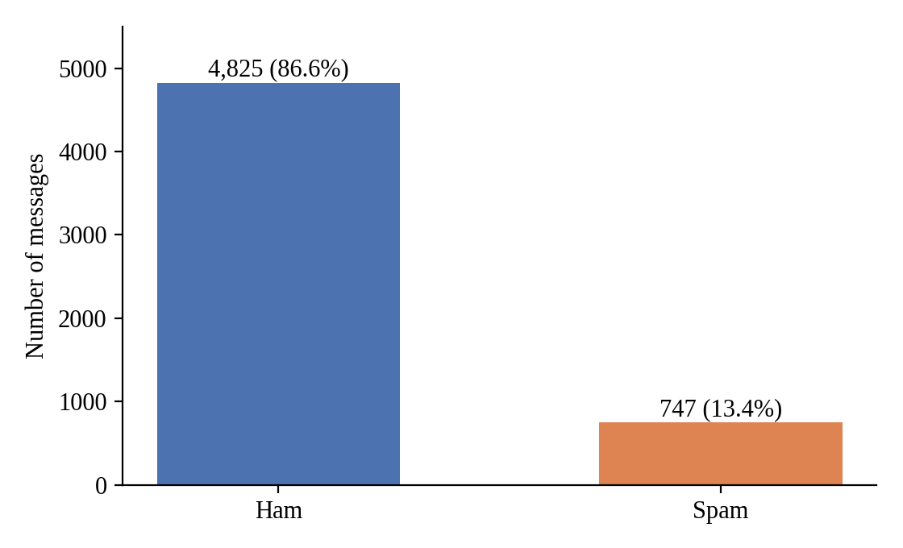
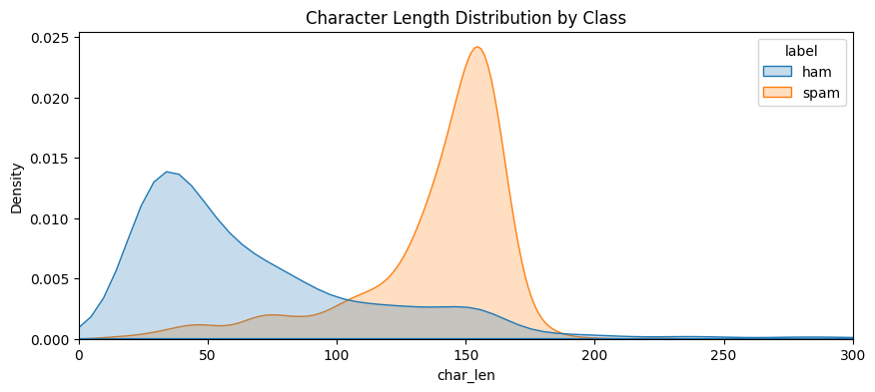
Data Exploratory Analysis
Predicting “ham” for everything
gives 86.6% accuracy but detects
zero spam, so accuracy alone is
misleading
Spam is longer and more uniform:
138.7 characters (SD 28.9) vs. ham
71.5 (SD 58.4)

Slide 9
Data Exploratory Analysis
Ham | Spam
Personal: know, love, call, friend | Promotional: FREE, call, text, reply
Time: now, later, today, tomorrow | Prize: claim, win, prize, won
Casual: u, ur, yeah, ok | Urgency: now, URGENT, STOP
Length and keywords help, but attackers beat them with obfuscation (“FR33”,
“W!N”) and conversational disguise. This motivates semantic evaluation.

Slide 10
04
Data Preprocessing

Slide 11
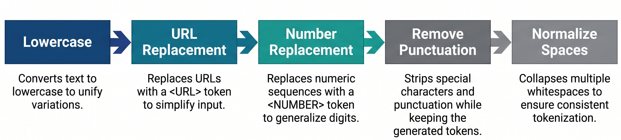
Data Preprocessing
Model-specific preprocessing:
Model | Input
TF-IDF + LogReg | Cleaned text, 3,000 unigrams, English stop words removed
BiLSTM | Top 5,000 tokens, padded/truncated to 50
DistilBERT | Raw text, WordPiece (30,522 vocab), 128 tokens, no stop-word removal
Labels are encoded ham = 0, spam = 1. Vocabulary and TF-IDF are fit on the training set only, so there is no data leakage.

Slide 12
05
Baseline Models

Slide 13
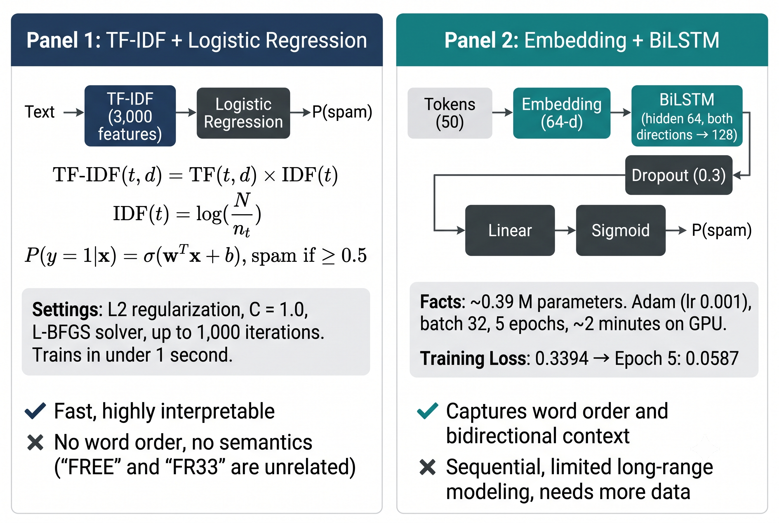
Baseline Models
One controlled comparison: same data · same split · same metrics · same seed (42)

Slide 14
06
DistilBERT Model- Working Principle

Slide 15
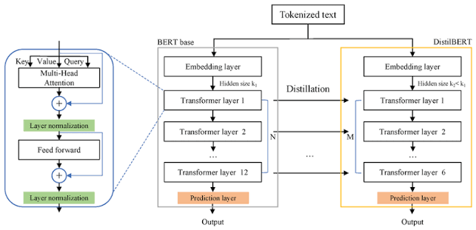
BERT-base vs. DistilBERT architecture figure
Parameter | Value
Encoder layers | 6
Hidden size | 768
Attention heads | 12 per layer
Parameters | 66 M
Vocabulary | 30,522 WordPiece
Max length | 128 tokens
Key points:
Why DistilBERT: 40% smaller and about 60% faster than BERT, and keeps about 97% of its language understanding
Subword tokens: “FR33” is split into pieces instead of becoming unknown
Self-attention: every token is weighed against every other, so “free” in “feel free to ask” ≠ “free prize”
Head: [CLS] representation → 2 logits → softmax → [P(ham), P(spam)]

Slide 16
07
Baseline Models– Coding and Implementation

Slide 17
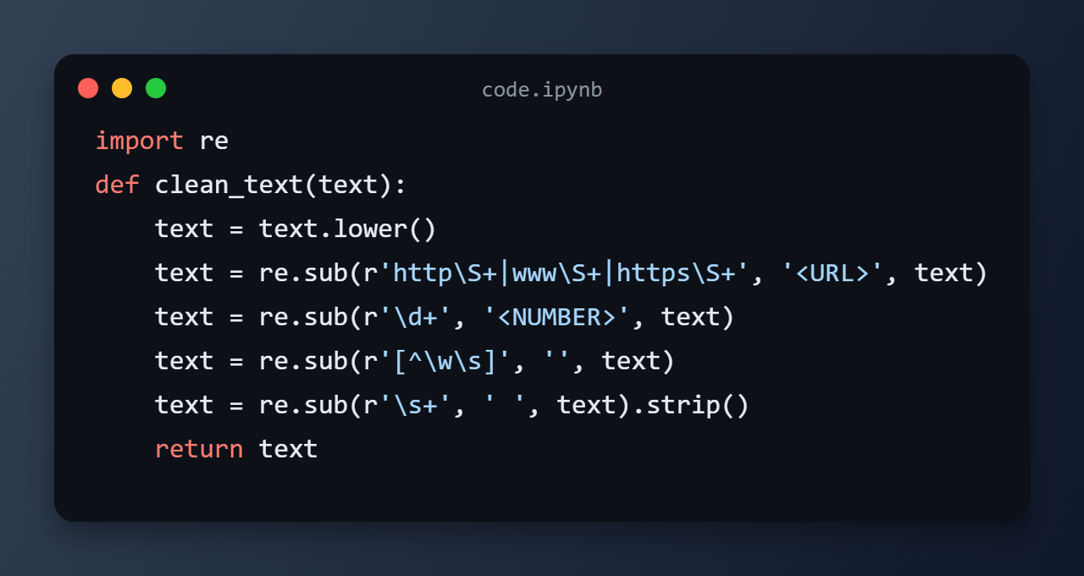
Baseline Models
Environment
Google Colab, NVIDIA Tesla T4 (16 GB), 12 GB RAM
Python 3.8.10 · PyTorch 2.0.1 · scikit-learn 1.2.2 · Transformers 4.30.2
All random seeds = 42
The same cleaned text feeds both baselines. TF-IDF and Logistic Regression are fit on the training set only.

Slide 18
08
DistilBERT Implementation

Slide 19
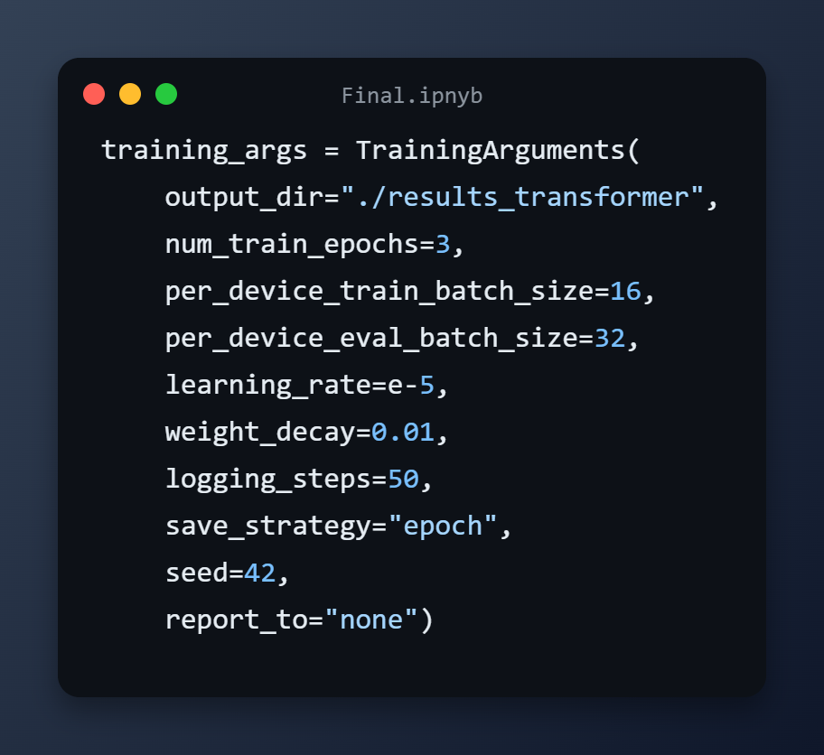
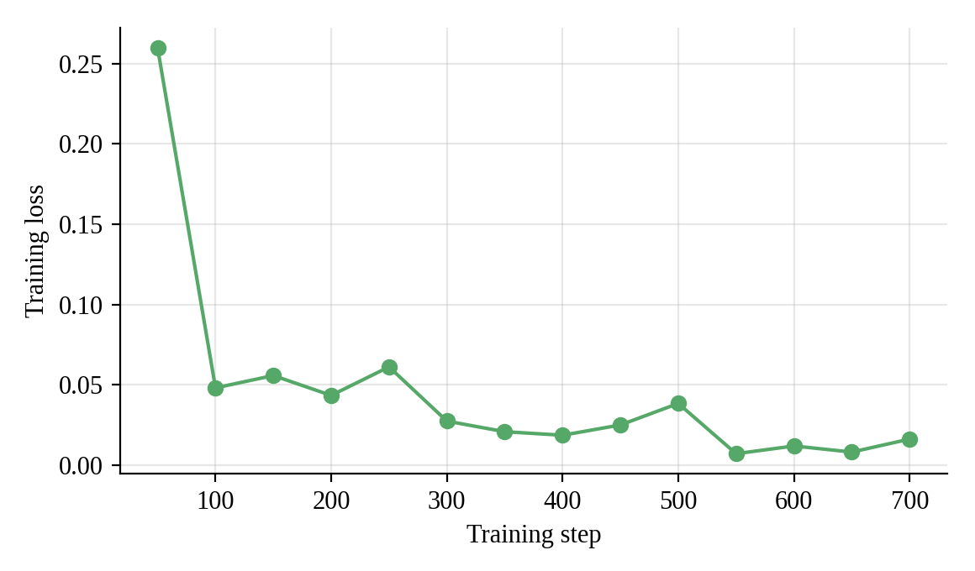
DistilBERT Implementation
Chips:
Model: distilbert-base-uncased via Hugging Face Trainer (AdamW)
Training time: about 2.5 min on a T4 GPU
Short schedule: pretrained weights already know the language, and a long run risks overfitting on 3,900 messages
Training loss fell from 0.2598 (step 50) to 0.0480 (step 100) and reached 0.0161 at step 700: stable convergence.

Slide 20
09
Model Comparison

Slide 21
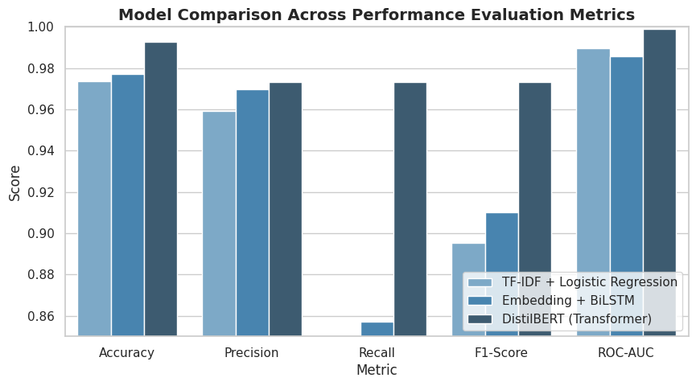
Results and Discussion
Product/website description: A brief overview of the product/website, including its key features, dimensions, and materials used
Features and benefits: A detailed explanation of the product's/website's features and how they will benefit the user
Technical specifications: A list of the product's/website's technical specifications, such as dimensions, weight, power requirements, connectivity options and hosting platform
Model | Accuracy | Precision | Recall | F1 | ROC-AUC
TF-IDF + LogReg | 97.37% | 95.92% | 83.93% | 89.52% | 0.9896
Embedding + BiLSTM | 97.73% | 96.97% | 85.71% | 91.00% | 0.9858
DistilBERT | 99.28% | 97.32% | 97.32% | 97.32% | 0.9990
The biggest gap is recall. DistilBERT detects 109 of 112 spam messages: +11.61 pp over BiLSTM and +13.39 pp over TF-IDF.
Spam = positive class, threshold 0.5. In security a missed threat is costlier than a false alarm, so recall is the most critical metric and F1 the primary comparison.

Slide 22
10
Error Analysis

Slide 23
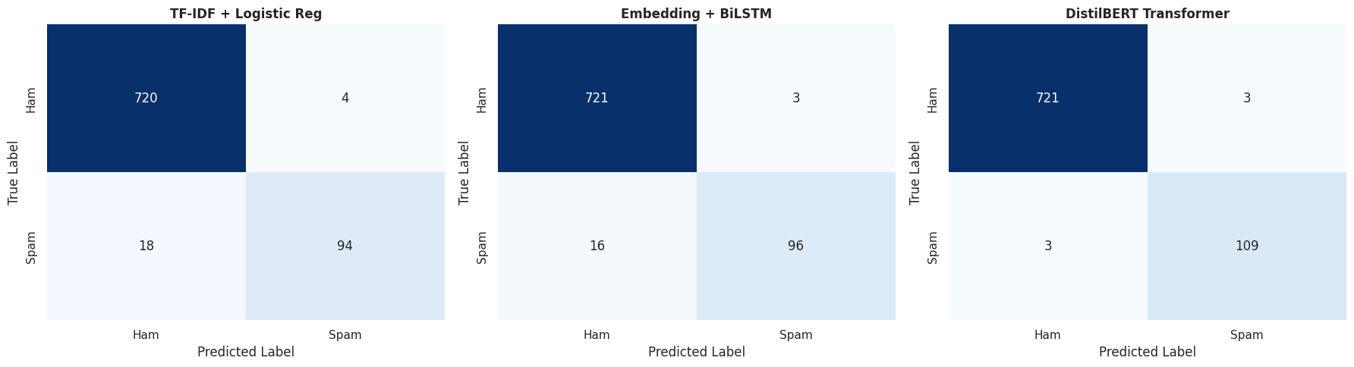
Error Analysis
missed spam
vs. TF-IDF
 | TF-IDF | BiLSTM | DistilBERT
False negatives (missed spam) | 18 | 16 | 3
False positives (false alarms) | 4 | 3 | 3
True positives | 94 | 96 | 109
-83.3%
about 1,794 more threats blocked per day than TF-IDF. (Extrapolation from the test set; assumes the same spam share and message mix.)

Slide 24
11
Conclusion

Slide 25
Conclusion
99.28% accuracy
97.32% recall
0.9990 ROC-AUC
−83% missed spam
Key findings:
DistilBERT outperformed TF-IDF + LogReg and BiLSTM on identical data, splits and metrics, so H1 is supported
It handles obfuscated phishing, social engineering and unusual but legitimate text
Pretraining helps even with a small labeled dataset, and a distilled model keeps cost manageable

Slide 26
Recommendations
Researchers: repeated runs and significance tests; multilingual and multimodal data
Practitioners: DistilBERT filtering with periodic retraining and a tunable threshold
Policymakers: support open, contemporary spam corpora

Slide 27
12
Semantic Context Evaluation I

Slide 28
Where Context Wins: Spam the Baseline Missed
Message (excerpt) | TF-IDF | DistilBERT | Why
“This msg is for your mobile content order… resent as previous attempt failed… Queries to customersqueries@netvision.uk.com” | Ham ✗ | Spam ✓ | No spam keywords, but a false premise, a manufactured problem and a contact point form a phishing structure
“CLAIRE here am havin borin time… U wanna cum over 2nite? Chat now 09099725823… Calls£1/min…” | Ham ✗ | Spam ✓ | Intimate tone vs. premium-rate number and buried charge notice
“Want explicit SEX in 30 secs? Ring 02073162414 now! Costs 20p/min” | Ham ✗ | Spam ✓ | Adult content + time pressure + per-minute charge, linked together
We examined test messages that TF-IDF got wrong and DistilBERT got right: 19 messages (2.3% of the test set) = 16 spam recovered + 3 legitimate messages recovered.
120 u/day
Output per worker

Slide 29
13
Semantic Context Evaluation II

Slide 30
Avoiding False Alarms and Why DistilBERT Wins
Five semantic mechanisms
Obfuscation resistance: intent detected without trigger keywords
Contextual coherence: the whole message is read, not isolated words
Structural pattern recognition: buried disclosures and spam templates
Intent understanding: playful or informational text vs. solicitation
Transfer-learning robustness: subwords and pretraining handle slang, rare words and misspellings
Message | TF-IDF | DistilBERT | Why
“U 2.” | Spam ✗ | Ham ✓ | After cleaning almost no features remain; DistilBERT reads “U 2” as “you too”
“Funny fact Nobody teaches volcanoes 2 erupt, tsunamis 2 arise…” | Spam ✗ | Ham ✓ | Rare words get high IDF weights and the length looks like spam; DistilBERT recognizes humor

Slide 31
11
Discussion & Future work

Slide 32
Discussion, Deployment and Future Work
What we can say
H1 supported: higher recall and F1 than both baselines
Self-attention links distant cues (number + cost disclaimer)
99.28% accuracy exceeds earlier reports (about 96–98%), but splits and metrics differ, so the comparison is only indicative
Limitations
Single split, single run, no significance test (only 112 spam in the test set, so each miss ≈ 0.9 pp of recall)
Data is old (2011–2012), English-only and UK-centric
Higher compute cost and less interpretability than TF-IDF
Character-level attacks may still hurt; latency was not formally benchmarked
What we can say:
Pipeline: SMS → Gateway → DistilBERT → P(spam) ≥ 0.5? → Quarantine / Inbox
Use GPU or quantization/ONNX at scale; retrain periodically for drift; tune the threshold
Future work: larger, recent, multilingual data (mBERT, XLM-RoBERTa); MobileBERT, RoBERTa and DeBERTa; ensembles, explainable AI and multimodal signals

Slide 33
Thanks You!

